Slide 1
Introduction to pytest
- simple, powerful, extendable test framework for python
Hong, Dongwei (Wayne)

Slide 2
Topics
Why pytest
Features
assert
mark
fixture
reporting
Plugins
More resources

Slide 3
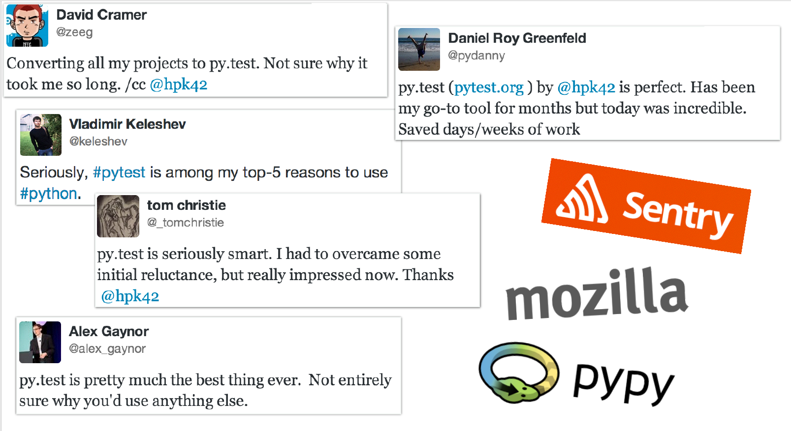
Used by organizations and projects
Projects:
requests
flask
tox
six
pypy
…

Slide 4
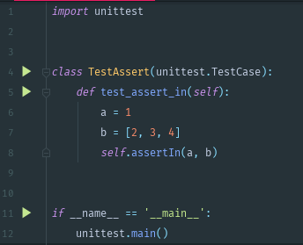

A Simple Test
unittest
pytest
more java style
more pythonic way

Slide 5
pytest make life easier
Assertions with plain assert statement
Subclassing TestCase is not required
Tests are found and collected with pytest command automatically.

Slide 6
pytest features
Detailed info on failing assert statements (no need to remember self.assert* names);
Auto-discovery of test modules and functions;
Modular fixtures for managing small or parametrized long-lived test resources;
Can run unittest (including trial) and nose test suites out of the box;
Python 2.7, Python 3.4+, PyPy 2.3, Jython 2.5 (untested);
Rich plugin architecture, with over 315+ external plugins and thriving community;

Slide 7
Assertion rewriting
Assertions about expected exceptions;
Detailed error message with context;
Special comparisons are done for a number of cases;
comparing long strings: a context diff is shown
comparing long sequences: first failing indices
comparing dicts: different entries

Slide 8
Mark
skip - always skip a test function
skipif - skip a test function if a certain condition is met
xfail - produce an “expected failure” outcome if a certain condition is met
parametrize to perform multiple calls to the same test function.
customized mark support

Slide 9

Fixture
As setup/teardown method in other framework.
1
A prime example of dependency injection.
2
Scope: sharing a fixture instance across tests in a class, module or session
3

Slide 10
Reporting
Junit-format xml to integrate with Jenkins and other popular reporting module
Install pytest-html to generate html report

Slide 11
Plugins
pytest-html
generate html report
pytest-xdist
test run parallelization
pytest-regression
generate baseline for regression test automatically
pytest-bdd
define test cases using Gherkin syntax
…

Slide 12
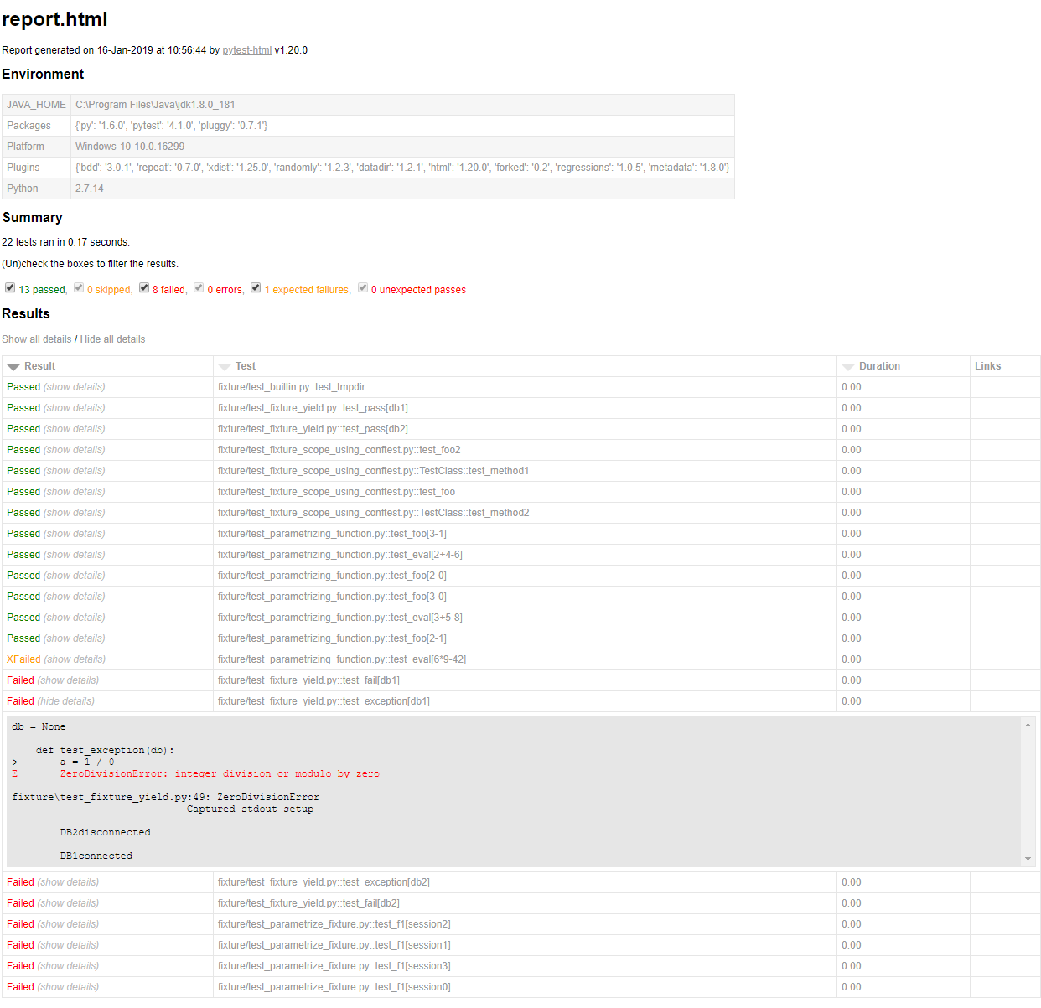
pytest-html

Slide 13
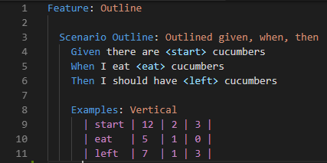

pytest-bdd
Write test case in Gherkin Syntax
test result

Slide 14

More resources
Demo project:
https://github.com/hdw868/pytest_demo
Further reading:
Python Testing with pytest(by Brian Okken)
Official document

Slide 15
Q&A

